Slide 1
Alzheimer disease detection
By omar Al Zoghbi

Slide 2
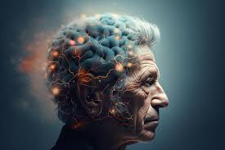
What is alzheimer
A progressive neurodegenerative disorder affecting memory, thinking, and behavior. Accumulation of amyloid plaques and tau tangles. Starts with mild memory loss and worsens over time. No cure.

Slide 3
The challenge
Detecting Alzheimer's disease is challenging due to early symptoms resembling normal aging or depression.
Early symptoms can be hard to notice, delaying diagnosis.
Expensive tests like PET scans and lack of easy-to-use markers complicate early detection.
ML models are needed to help identify if a patient has Alzheimer's.

Slide 4
Project goal
Build a machine learning model to predict Alzheimer's disease.
Analyze data to identify patterns indicating the disease.
Assist in early detection of Alzheimer's.
Improve diagnostic accuracy for better outcomes.

Slide 5
Dataset for the ml models
The dataset was sourced from Kaggle.
It includes patient demographics, health conditions, lifestyle factors, and clinical assessments.
A subset of relevant features will be used for model training.
Selected features aim to improve accuracy in predicting Alzheimer's disease.

Slide 6
Algorithms used
Two algorithms will be used: Random Forest Classifier and K-Nearest Neighbors (KNN) Classifier.
Random Forest improves prediction accuracy by combining multiple decision trees and reducing overfitting.
KNN is a simpler, instance-based algorithm that classifies patients based on feature similarity.

Slide 7
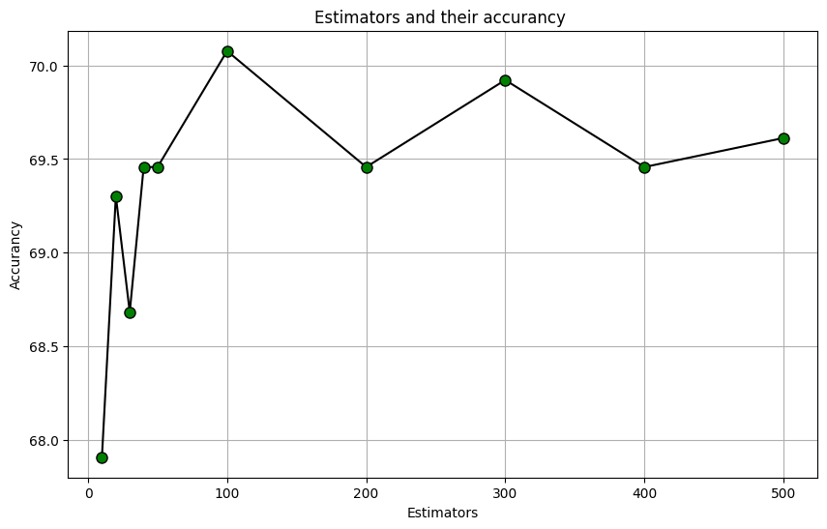
Choosing best n estimator for random forest
AS WE CAN SEE THE BEST N ESTIMATOR WHICH IS THE NUMBER OF DECISION TREES THAT GIVES THE BEST ACCURANCY IS BETWEEN 0 AND 100

Slide 8
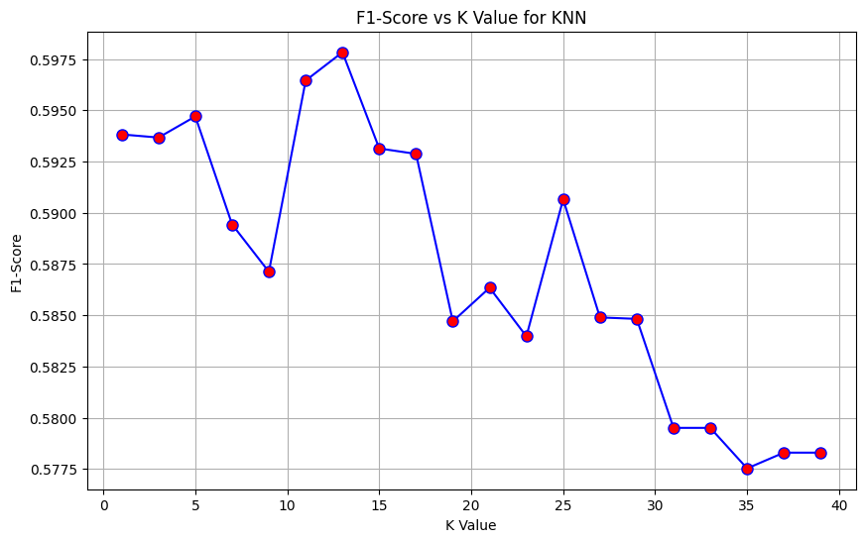
Choosing best k value for knn
ON THE OTHER HAND THE BEST K VALUE IS THE ONE WITH THE HIGHEST F1 SCORE VALUE WHICH IS ABOUT 13

Slide 9
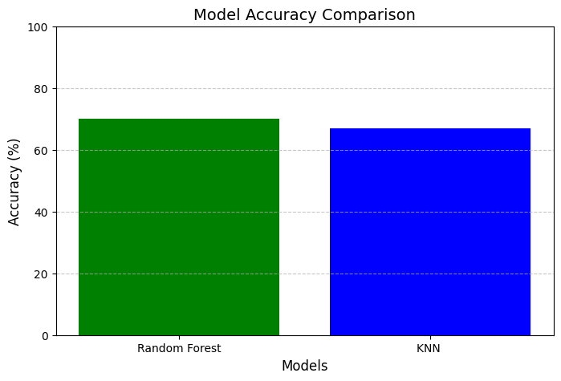
Comparing the two algorithms
AS WE CAN SEE THERE IS A SLIGHT DIFFERENCE BETWEEN THE RANDOM FOREST AND THE KNN ACCURANCIES

Slide 10
Learning outcomes of the course
Comprehend the fundamental principles of machine learning, including supervised, unsupervised, and reinforcement learning.
Distinguish between different types of models (e.g., regression, classification, clustering).
Understand the importance of feature engineering, data preprocessing, and model evaluation.

Slide 11
Thank you

